Slide 1
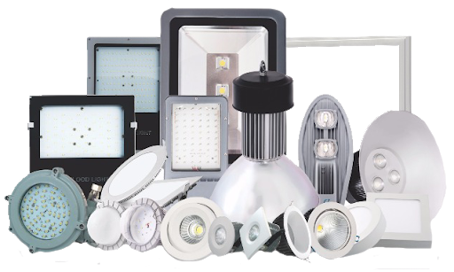
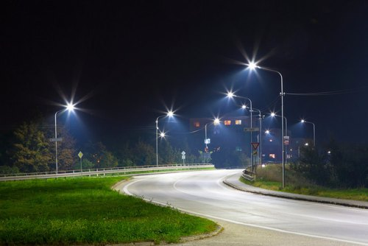
Professional Lighting
Osman Powertech & Engineering.
Let’s Build the Future with Innovation
House # 1/A(3rd Floor), Road # 1/B, Nikunja -2, Khilkhet, Dhaka-1229, Bangladesh.
Telephone : +88028858974 ; Email: info@2btexcorp.com ; Website: www.2btexcorp.com

Slide 2
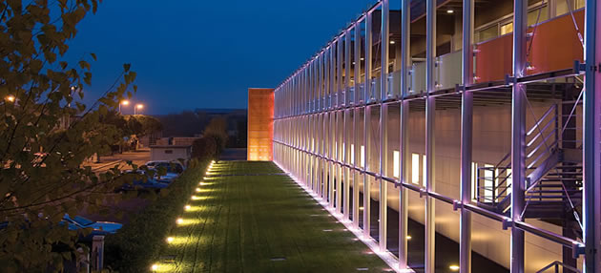
Company Summary
2B Tex Corporation is specialized in the Lighting, Energy, Construction, Textile Chemicals and Dyes sector by absorbing in-house very experienced and senior engineers in both the Professional Lighting, Renewable Energy, Textile Chemicals & Dyes, Construction Sector. Organic Farming is our dream project, we already started work at our owned agricultural land at Khalu, Bogra. These engineers have been inducted into our higher management so that we can smoothly implement large international projects in this very crucial sector for the country. Our company is closely associated with projects from the planning stage. We have gained remarkable reputation by providing quality engineering services & products. With the development of new technology we are well positioned to make use of our experience in completing projects on or ahead of time.
In 2015, 2B Tex Corporation has started their journey specialized in developing, supplying, sales & Marketing of international standard Textile Chemicals & Dyes and also started Civil Construction business in different Government and private Entities.
In 2021, some experienced BUET Graduates and the directors of 2B Tex Corporation who have long experience in Textile and Garment industries Joined together and started their engineering venture named as “Osman Powertec & Engineering”. Professional Lighting, Renewable Energy, Organic Farming, Civil Construction and Textile & Dyes Chemical are their targeted line of business. The main slogan of company “Let’s Build the Future with Innovation”.
Osman Powertec & Engineering believes that by utilizing modern technologies & innovative approach. We believe our Engineering services & Products quality will make our customer satisfied. We have skilled technical and supporting team which is expert in implementation any types of Government and Private Projects.
We ensure customer satisfaction through the best business practices and responsibility combined with strategic and effective partnerships for prompt delivery of customized solutions.

Slide 3
Vision
To build an organization that Innovates, Investigates and Discovers
Mission
To inspire curiosity and Discovery for success in the rapidly changing world

Slide 4
How WE Works
Consulting
Planning
Development
Financing
Implementation
Operation &
Service
Core Values
Integrity
Excellence
Customer Satisfaction
Innovation
Encouraging People
Integrity: All dealings with integrity, it’s our asset.
Excellence: the quality of being excellent.
Customer Satisfaction: Overall Commitment for Customer.
Innovation: We believe our innovation, thinking about new technology.
Encouraging People: Good dealings with people’s
Values

Slide 5
Company Timeline
.
2016
2018
2020
Established on 2015,
Sole Agent of Oxford Technologies Australia (Denim)
Sole Agent of Totas International Trading Company Limited (Taiwan)
Started working with Ministry of Education.
Established new venture “Osman Powertech & Engineering”
Sole Agent of Noga Biochem (China)
Started New Business scope of Building and Road Construction.
Established Intense Communications as a Event Management Firm also sole agent of Cargill (Turkey)
2015
2017
2019
2021

Slide 6
Line of Business
2b Tex Chemicals and Dyes
Osman Powertech Professional Lighting
2B Tex Power
2B Tex Construction
Intense Denim fabric and Garments
Organic (Abdul Latif Agro Farm)

Slide 7
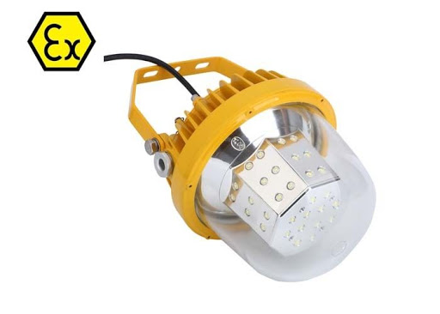
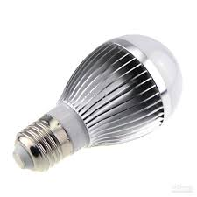
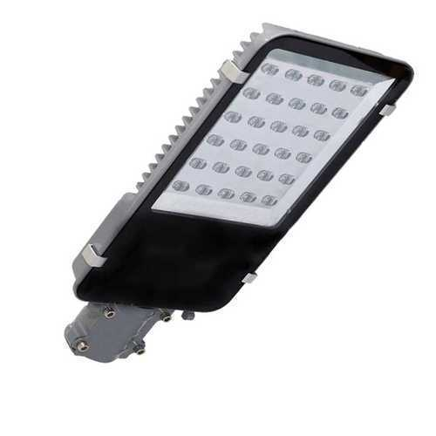
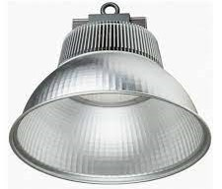
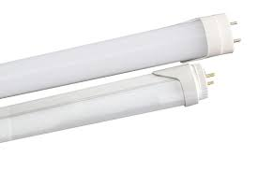
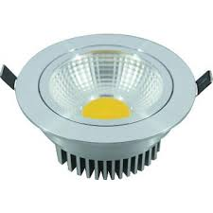
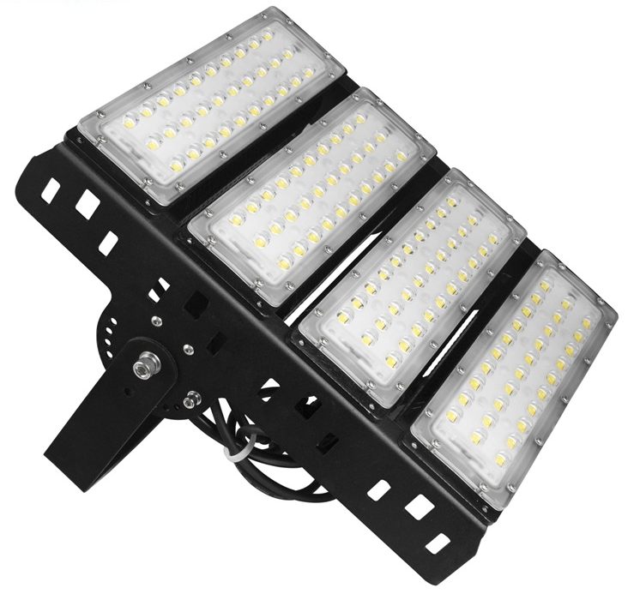
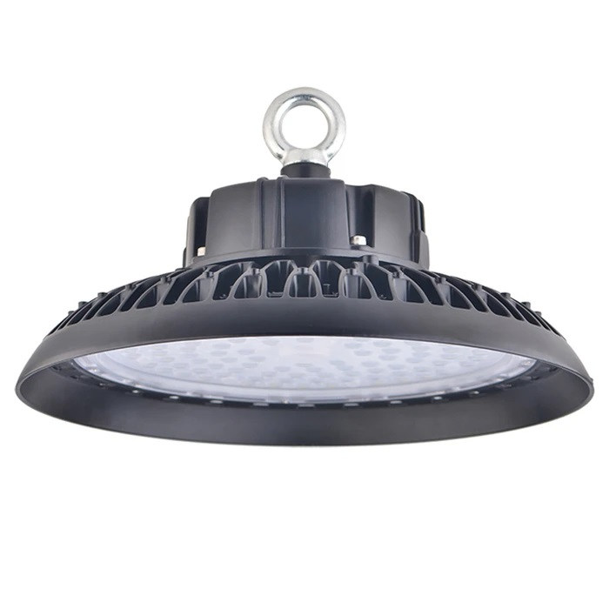
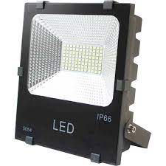
Osman Powertech Professional Lighting
Lumitech Management have almost 12 years experience in commercial lighting segment. we are experienced in production, assembling and quality controlling. They are specialist in LED lighting. we directly go to customers’ site, analyses customer requirements and accordingly they give solution. we are expert both in Corporate/Industrial and Project Lighting.
Corporate/Industrial Lighting
Bulb
Panel Light
Street Light
Explosion Proof Light
High Bay Light
Tube Light
Decorative Light
Flood Light
High Mast Light
UFO Light

Slide 8
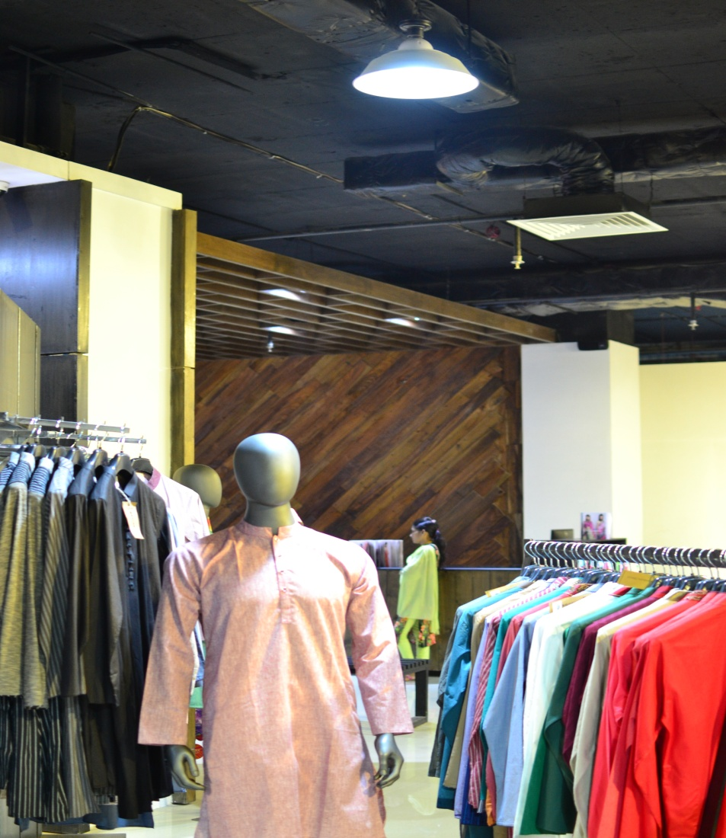
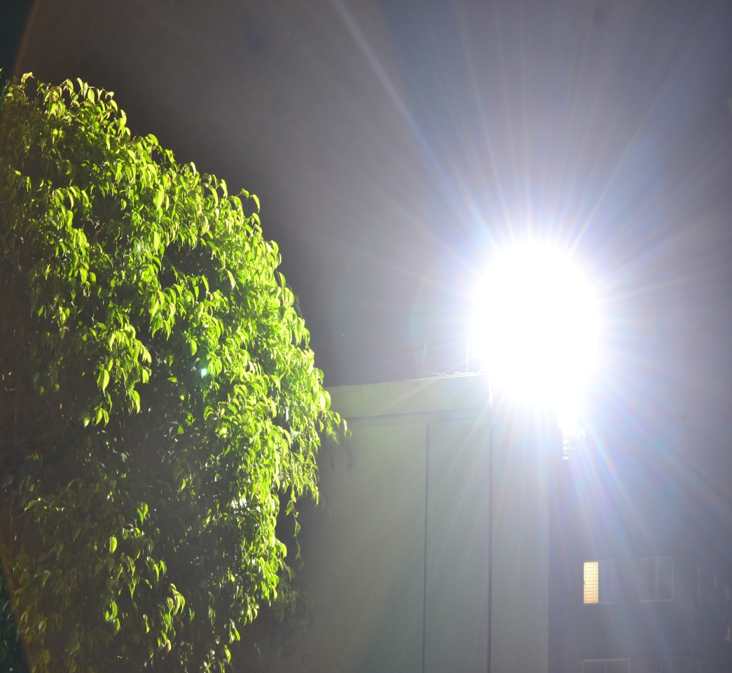
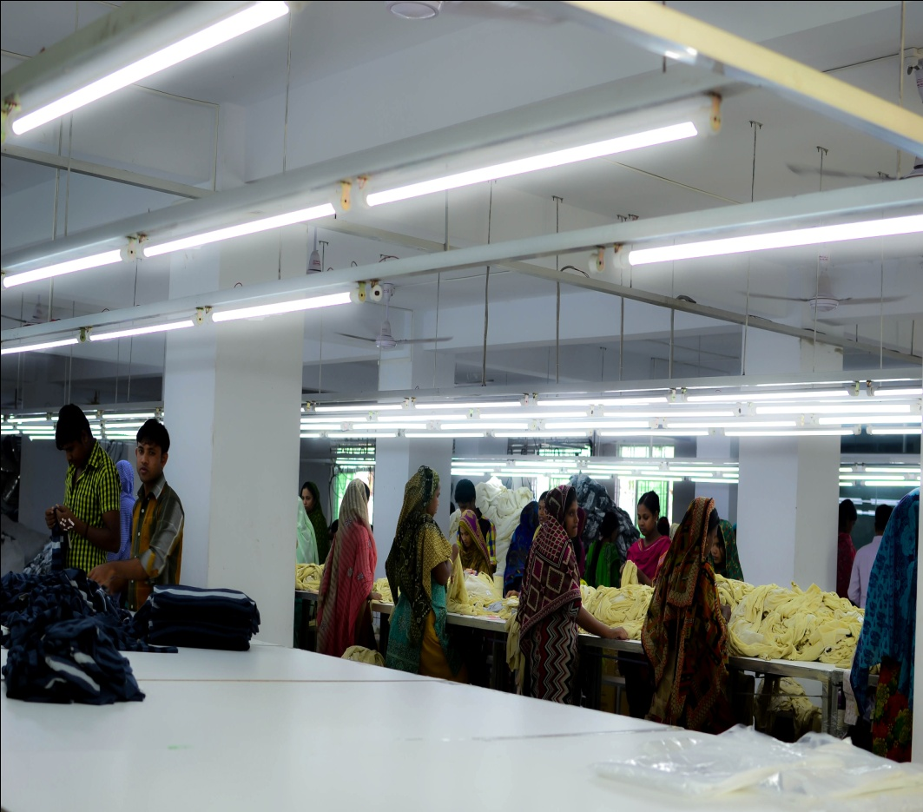
Osman Powertech Professional Lighting
We have supplied LED Lights in different Corporate offices, Garments and Industries in Bangladesh.
Corporate/Industrial Lighting
Major Corporate Customers are - Akij, Pepsi, Cocola, Transcom, Beximco, Incepta, Popular, LEED Certified Garments, AKH Group, Lyric, Basundhara, Pallmal, Rangs, Amtranet, Abed Textile, BDG Group, Bengal Group, Fakir Fashion, Unilever, Walton, KSRM, BSRM etc.

Slide 9
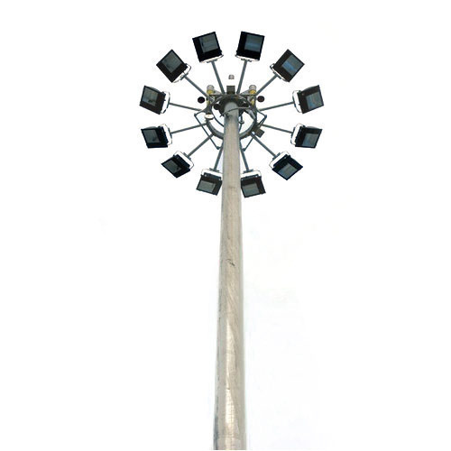
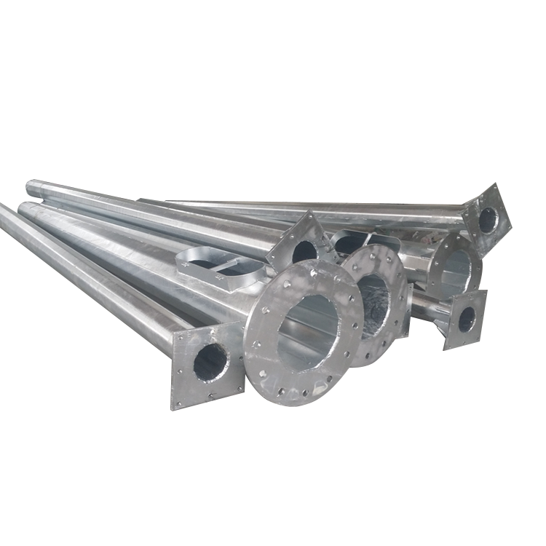
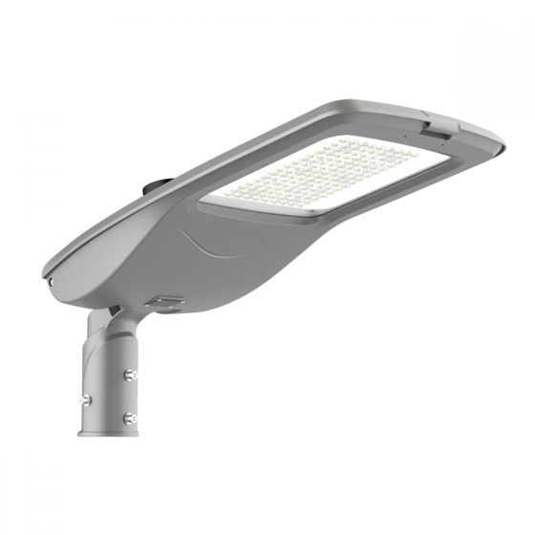
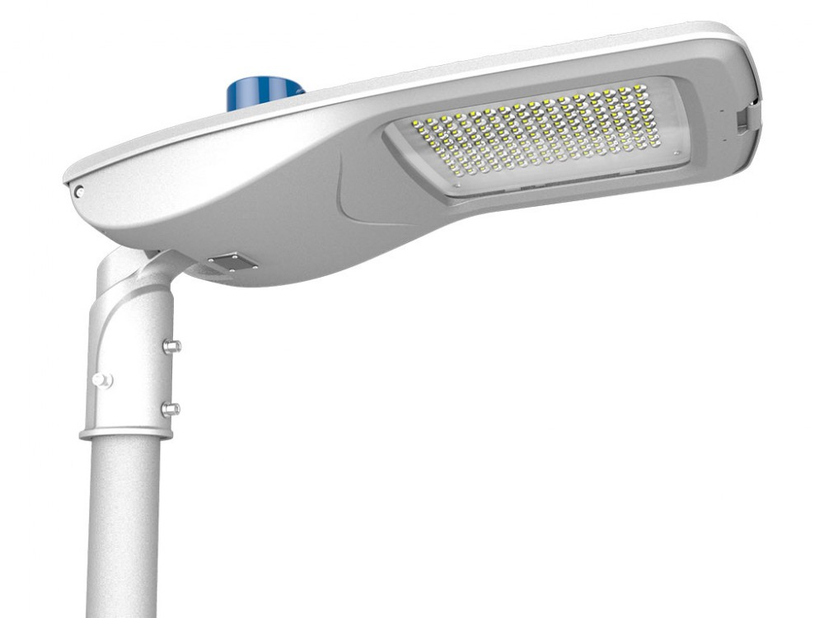
Osman Powertech Professional Lighting
Project Lighting – AC Street Light & Flood/High Mast Light
Project Lighting division is experienced and specialized for supplying and installation of Street Light & Flood/High Mast Light for different City Corporations, Pouroshovas, Upazilas & Stadium under Government Tender. As per tenderer requirement we supplied Lights of EU, USA and others country origin.
Our Product & Service:
We provide proper design and Implementation of this project as per customer requirement.
We can Provide for this project (Overhead cable with laying, GI Pole fabrication, Lighting Arm design & Fabrication, Wire Rack, Shackle Insulator, Earthing and Other Related Civil Work, Garden Lighting) etc.
We can provide installation support and Ensure the after sales service support.

Slide 10
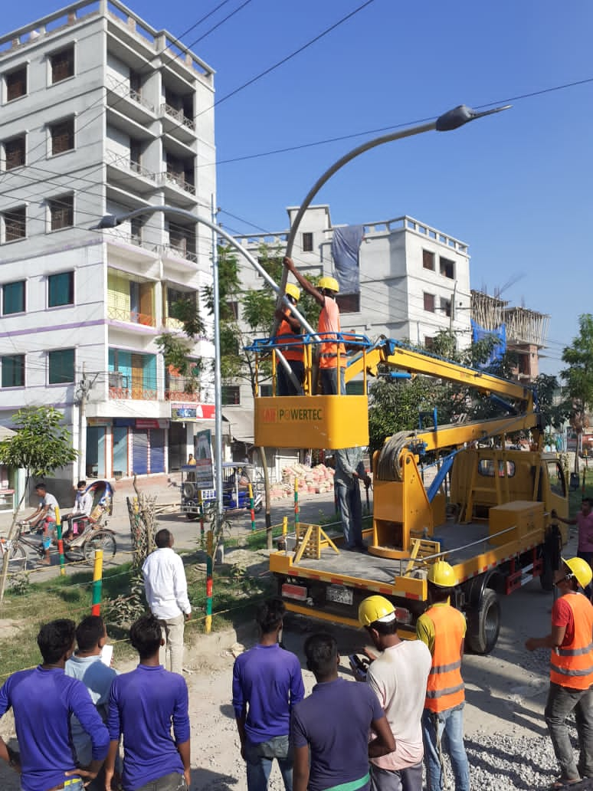
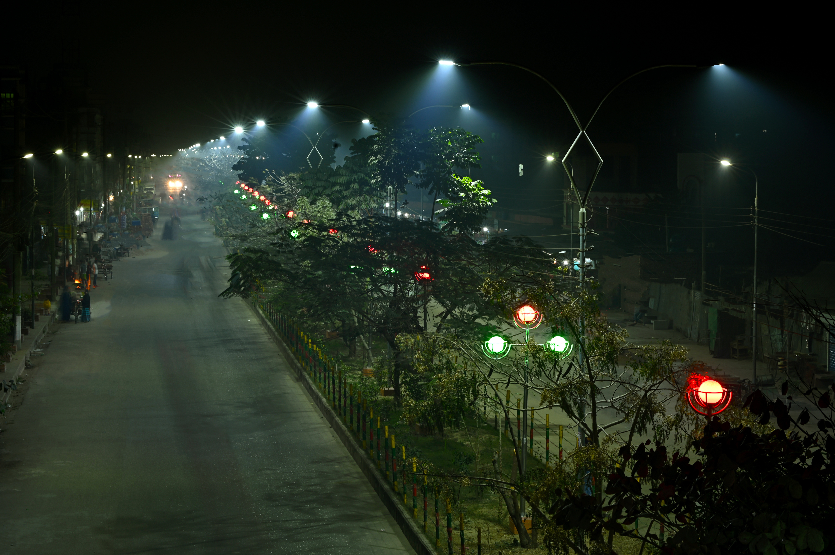
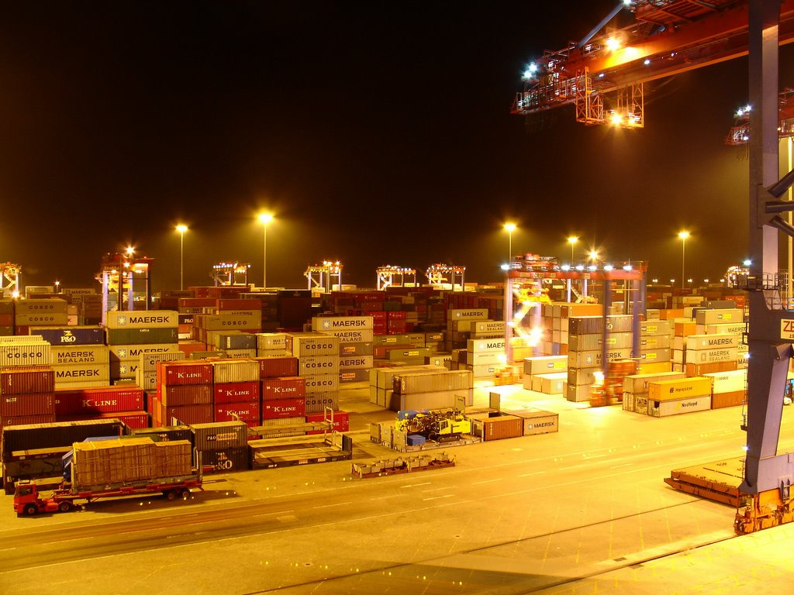
Osman Powertech Professional Lighting
Project Lighting – AC Street Light & Flood/High Mast Light
We have Supply and Installed 5,135 LED Street Light in different City Corporations, Upazilas and Industries in Bangladesh
Sylhet City Corporation, Jessore City Corporation, Narayangonj City Corporation and Mymensingh City Corporation, where we supplied and installed Street Lights. Supplied High mast light at Chittagong Port. Also supplied Explosion Proof Light at Meghna Petroleum.

Slide 11
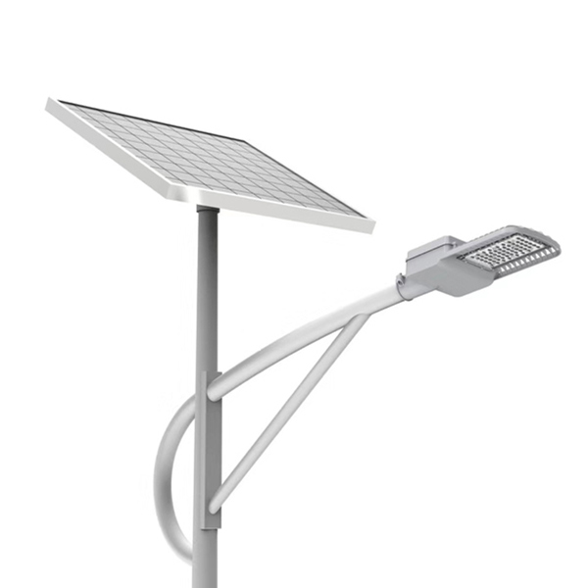
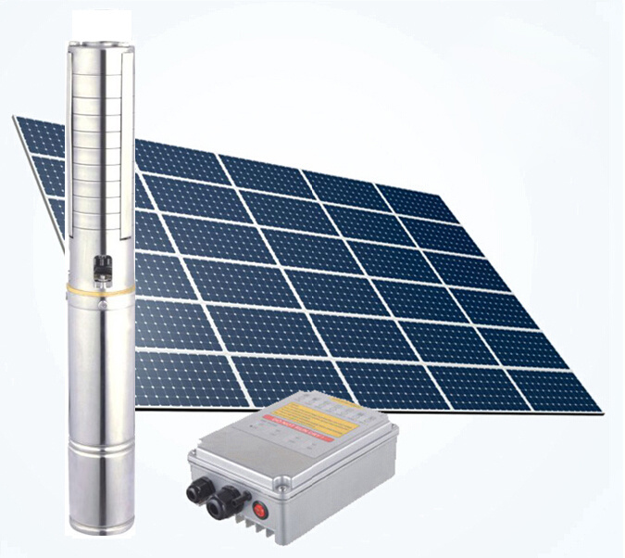
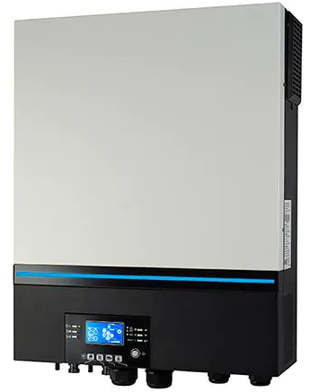
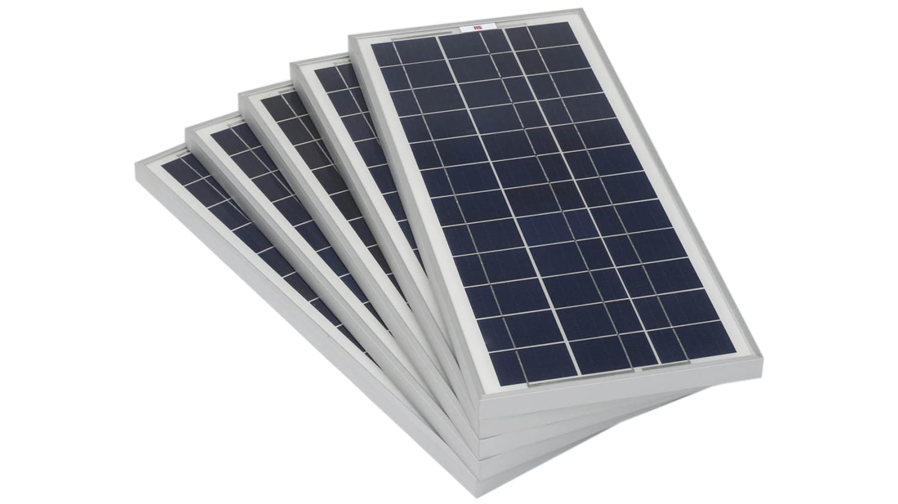
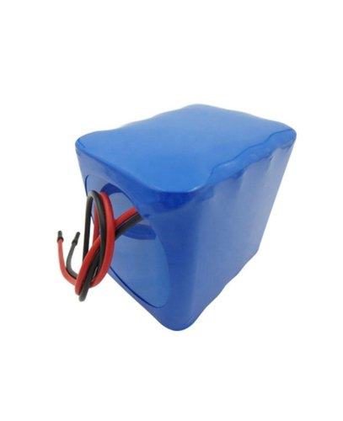
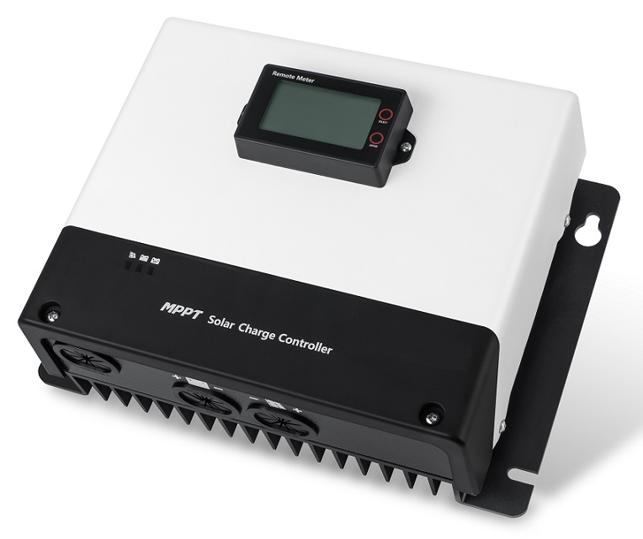
Osman Powertech Professional Lighting
Lumitech management have 10 years experience in renewable energy business. Under this division we supply and installed Solar Home System ; Off-Grid, On-Grid & Hybrid Solar System; Solar Irrigation Pump; Solar System for Net-Metering; Solar Street Light under guidance of IDCOL and SREDA.
IDCOL & SREDA Approved Products
Solar Panel (30Wp to 330Wp)
Charge Controller
Off-Grid, On-Grid & Hybrid Inverter
Solar Integrated Street Light (15W, 20W & 30W)
LiFePO4 Battery for Solar Street Light
Irrigation Pump
Solar Irrigation Pump
Solar Street Light
Solar Charge Controller
Solar Inverter
Solar Pane
LiFePO4 Battery

Slide 12
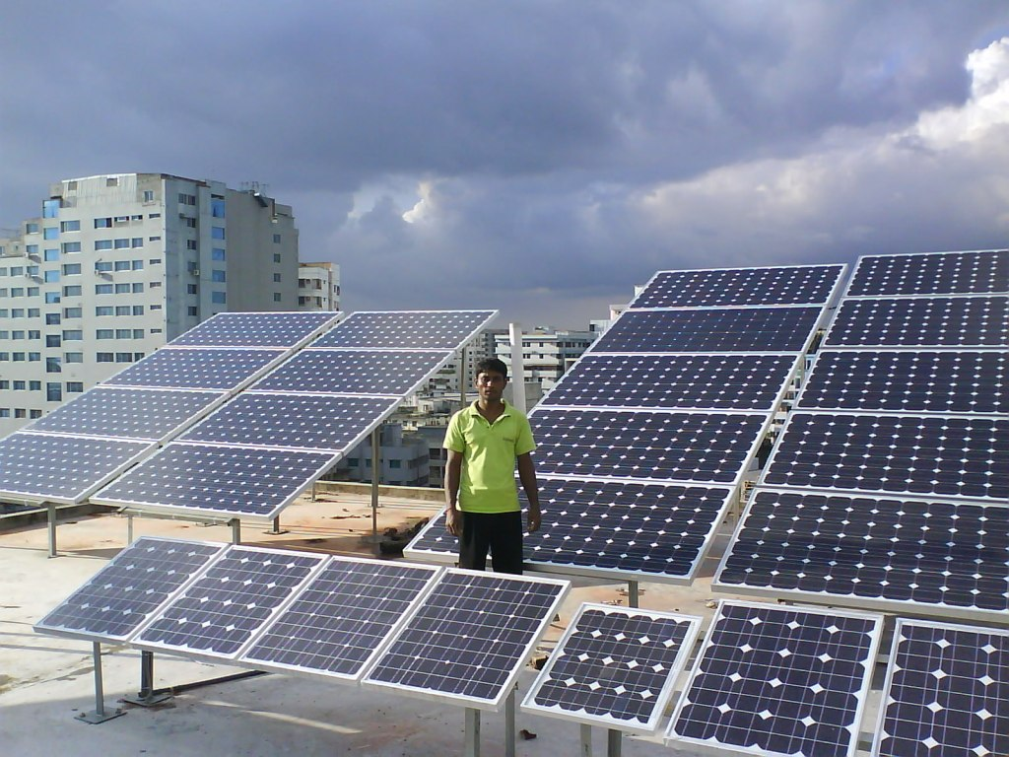
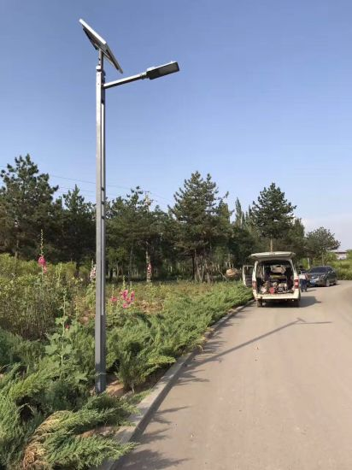
Osman Powertech Professional Lighting
Our Services :
We can provide design for Solar System under IDCOL & SREDA guide lines, System commissioning work (1KWp to 500KWp) with battery/With out Battery Back up. Also provide major product which is related of this system (Solar PV Module, Charge Controller (PWM + MPPT), On Grid, Off Grid, Hybrid Inverter, Battery, Bi Directional Inverter) and other related structure & accessories
We can provide design for Solar Street Light under IDCOL & SREDA guide lines, System commissioning work (15W,20W,30W LED Street Light). We provide full related product (Solar PV Module, LED DC Street Light with Battery & Controller), GI Pole with Fabrication and Civil Related Work and other related accessories.
We design, supply and installed Solar Irregation project (Solar PV Module, Pump Controller, Submersible/Surface Pump, Solar Frame, Boring) etc under IDCOL and SREDA guide lines.

Slide 13
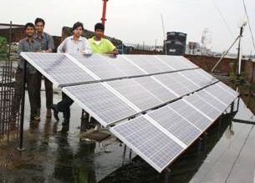
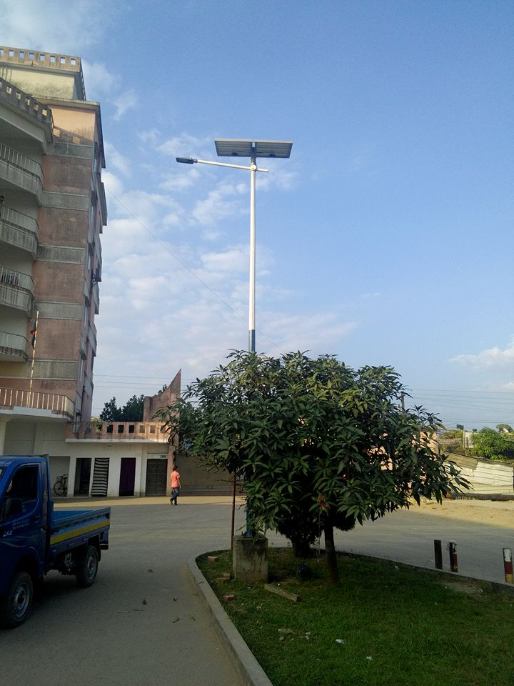
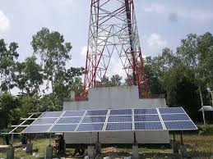
Osman Powertech Professional Lighting
Management Experience :
Our managements have experienced to set up 179 branch offices and installed 100,643 nos. SHS, total capacity around 8.5 MW in different Rural Off-Grid areas of Bangladesh.
Have installed 1425 nos. Solar Roof Top System (total capacity 2.45 MW) in the Roof of different House Buildings and industries of different cities and industrial areas of Bangladesh.
Have installed 15,705 nos. Solar Street Lights in different Off Grid and On Grid areas of Bangladesh
Have installed 62 nos. Solar Irrigation Pump in different Off Grid and On Grid areas of Bangladesh as a replacement of Diesel Pump.
To implement the GREEN ENERGY in all Base Transmission Station (BTS), have installed 213 nos. Solar, Battery and Generator hybrid systems.
Have installed “Cement-Brick” and “Fiber-Glass” bio digester model Biogas plant. Mostly installed in Poultry Firms, Cattle Firm and House hold. Capacity: Small Scale ( 2.4-4.8 CM) and Medium Scale ( 7.5 to 20 CM) .

Slide 14
“Let’s Build the Future with Innovation”

Slide 15
For your queries
Osman Powertech & Engineering House# 1/A, Road# 1/B, Nikunja-2, Khilkhet, Dhaka-1229, Bangladesh
Mobile : +8801788933931
e-mail: info@2btexcorp.com
Web: www.2btexcorp.com
Thank You

